Slide 1
Using Filter Operations

Slide 2
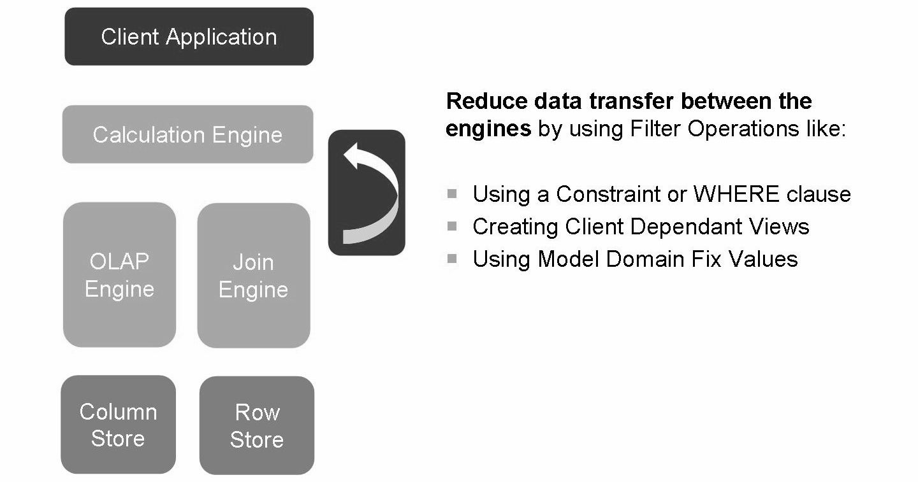
Filtering Data
Most of time, users do not need the whole data perimeter stored in the source system.
use filters to display only relevant data to users
decreasing data volume leads lower reporting response time

Slide 3
A primary goal during modeling is to minimize data transfers between engines.
This statement holds true both internally, between the SAP HANA database views, and also between SAP HANA and the end user application.
For example, the end-user will never need to see 1 million rows of data. They would never be able to understand so much information or consume it in some meaningful way.
This means that Data, wherever possible, should be aggregated and filtered to a manageable size before it leaves the data layer.
When deciding upon the records that should be reported upon, a best practice approach is to think at a “set level” not a “record level”. A set of data can be aggregated by a region, a date, or some other group in order to minimize the amount of data passed between views.

Slide 4
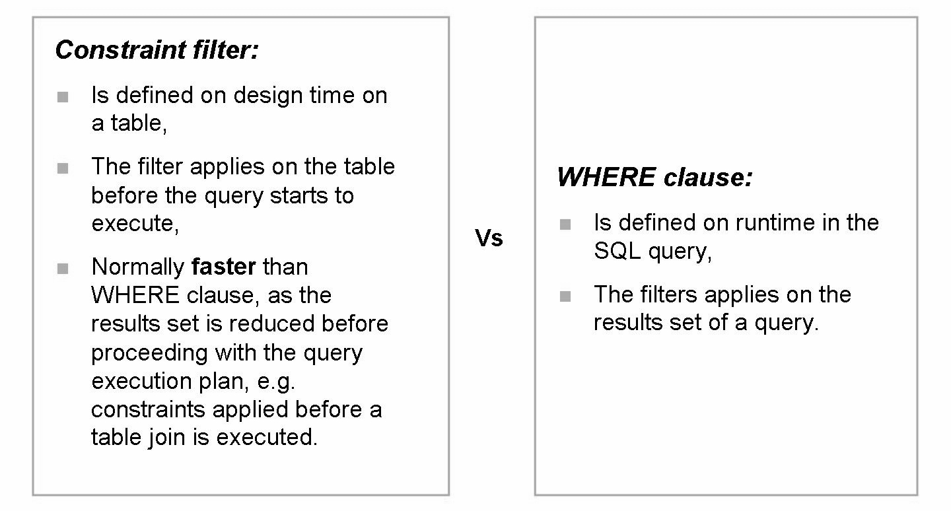
Compare Constraint Filter and WHERE Clause

Slide 5
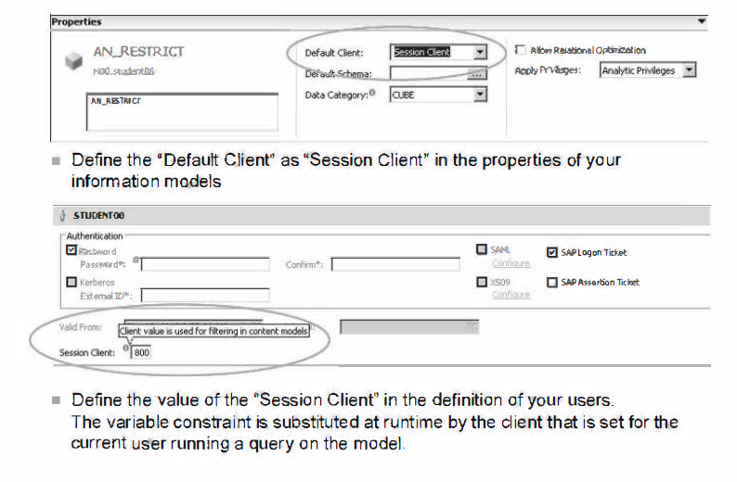
Create Client Dependent Views

Slide 6
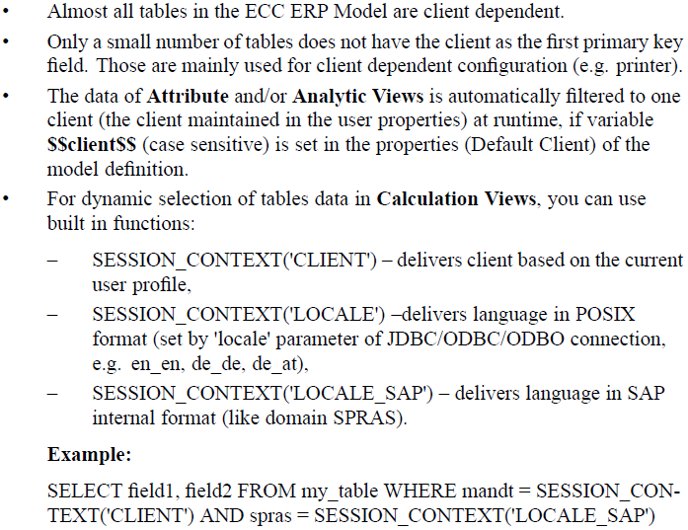

Slide 7
Domain Fix Values or Model Fix Values
Domain Fix Values are used for several fields. They are basically simple value lists with language dependent texts. Actual values are stored in database tables (DD07L, DD07T).
During the initialization of the replication two tables are created for each used Domain. Please consider that currently only those domain values are taken that are active (Field AS4LOCAL = 'A' in DD07T).
The naming convention for these tables is DOM_<Domain Name> for the Domain values and DOM_<Domain Name>T for the language dependent texts (Example: DOM_MEPRF and DOM_MEPRFT, DOM_BFART and DOM_BFARTT).
They are located in the same schema as the replicated tables.
You can build Attribute Views for those tables to be used in analytical or calculation views. Please include both related tables and create a text join with language field DDLANGUAGE. Include field DOMVALUE_L as key field in the output structure and add field DDTEXT (Description mapping (for DOMVALUE_L to field DDTEXT of joined text table) does not work with all clients).
Domain fix values are created for ECC and for CRM separately.

Slide 8
THANK YOU
Courtesy : SAP Labs Document -
HA 300 – SAP HANA Implementation and Modeling

